Slide 1

MIT WORLD PEACE UNIVERSITY
Dept. of Electrical and Electronics Engineering
COURSE: DATABASE MANAGEMENT SYSTEM
ECE Lab Equipment Inventory Tracker
Pawan
[1262241202]
&
Liya Gautam [1262241149]
PRESENTED BY:

Slide 2
// AGENDA
Presentation Flow
01
Problem & Objectives
04
Implementation
Context and system goals.
Integration and core queries.
02
Tech Stack
05
Applications
Software requirements & tools.
Real-world industry relevance.
System Design
03
06
Future Scope
ER diagram and table schema.
Extensions and conclusion.
07
Mapping
Sustainable Development Goals.

Slide 3
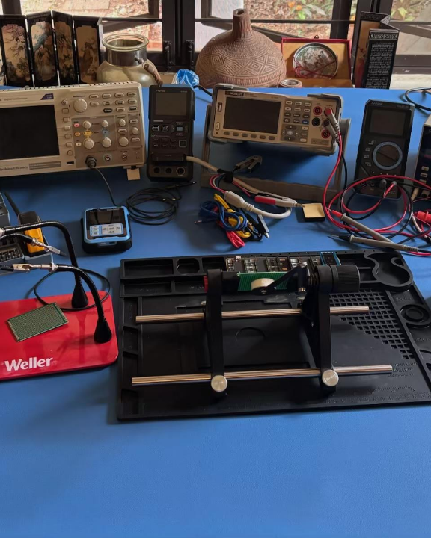
// THE PROBLEM
Replacing manual lab ledgers.
Physical logbooks lead to data loss and missing equipment.
No centralized way to audit current hardware stock.
Need for a strict relational system to enforce accountability.

Slide 4



// SOFTWARE REQUIREMENTS
The Technology Stack
Frontend UI
Backend Server
Database
HTML5 & CSS3.
Python Flask framework.
MySQL relational storage.

Slide 5
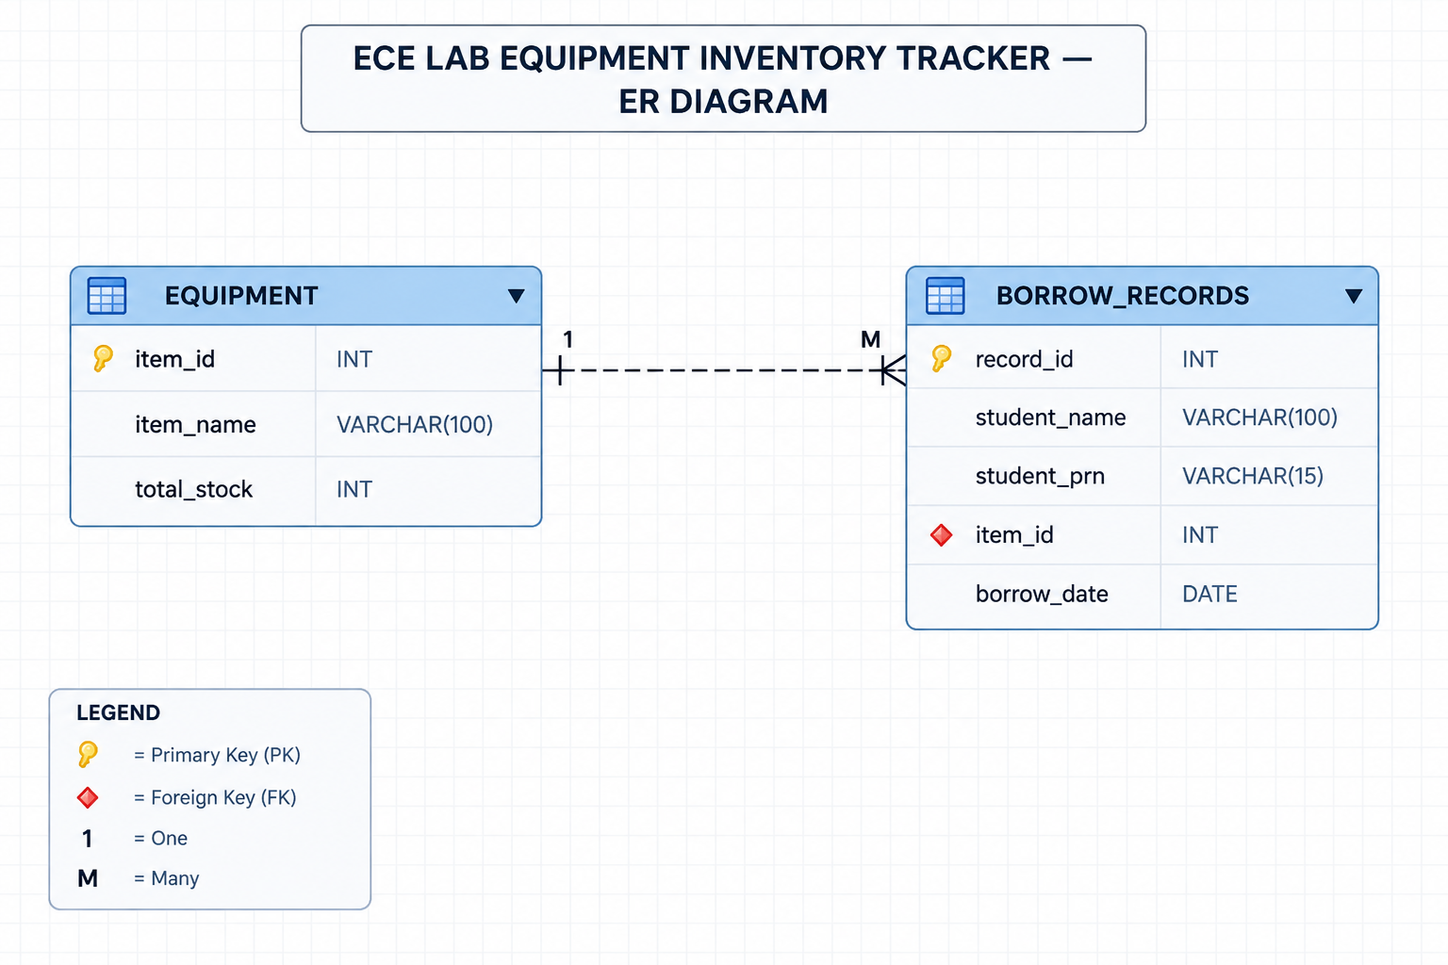
// ER DIAGRAM

Slide 6
// SYSTEM DESIGN
Relational Table Schema
Borrow_Records
Equipment Table
CHILD ENTITY
PARENT ENTITY
record_id (PK)
item_id (PK)
1 : Many
student_name
item_name
student_prn
total_stock
item_id (FK)
borrow_date

Slide 7
// IMPLEMENTATION
Admin Dashboard Query
SELECT Borrow_Records.record_id, Borrow_Records.student_prn, Equipment.item_name, Borrow_Records.borrow_date FROM Borrow_Records JOIN Equipment ON Borrow_Records.item_id = Equipment.item_id ORDER BY Borrow_Records.borrow_date DESC;
SELECT Borrow_Records.record_id, Borrow_Records.student_prn, Equipment.item_name, Borrow_Records.borrow_date FROM Borrow_Records JOIN Equipment ON Borrow_Records.item_id = Equipment.item_id ORDER BY Borrow_Records.borrow_date DESC;
A relational SQL JOIN links the student log to the specific hardware inventory name.
Prevents data redundancy.

Slide 8

// NEXT STEPS
Future Scope & Extensions
Live Stock Deduction
Return Workflow
Authentication
Implement SQL triggers to reduce stock count automatically upon issue.
Update statements to log component returns and replenish inventory.
Secure the admin dashboard using Werkzeug password hashing.

Slide 9
// MAPPING
SUSTAINABLE DEVELOPMENT GOALS (SDGs)
How the ECE Lab Equipment Inventory Tracker can contribute
SDG 4
SDG 12
SDG 9
QUALITY EDUCATION
RESPONSIBLE CONSUMPTION
AND PRODUCTION
INDUSTRY, INNOVATION
AND INFRASTRUCTURE
Organized borrowing records can support administration of equipment used in practical laboratory sessions.
Centralized equipment and borrowing records can improve traceability and encourage responsible use of shared resources.
The project demonstrates a small-scale digital workflow for institutional inventory management.
Project link: better visibility of issue records for educational lab equipment.
Project link: searchable borrowing history; stock deduction and returns are future work.
Project link: Flask + MySQL replace part of a paper-based process.

Slide 10
Conclusion
A successful implementation of DBMS principles resolving physical inventory management in university laboratories.
// REFERENCES
[1] R. Elmasri, Fundamentals of Database Systems
[2] MySQL 8.0 Reference Manual

Slide 11

Image Sources
https://i.redd.it/k2kz6okpz4gh1.jpeg
Source: www.reddit.com
Thank You!

